Slide 1
How to use naloxone
Training for “ ”
Ariel Johnson
Community Prevention Coordinator
Richland County Health Department
Melissa Gaukler, RN, BSN
Public Health/ School Health Nurse
Richland County Health Department

Slide 2
Educational objectives
At the conclusion of this presentation, participants will be better able to:
Explain the problem of opioid addiction
Explain how naloxone (Narcan) works when administered to a person who has overdosed
Recognize the signs of an opioid overdose
Properly administer naloxone (Narcan) in the event of an overdose

Slide 3
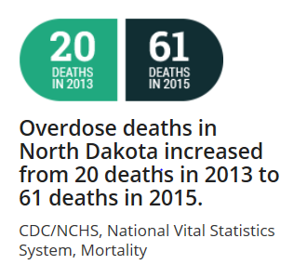
National/ State Opioid Statistics
According to the CDC more than 64,000 lives were lost in 2016 due to opioid related overdoses (including prescription opioids and heroin)
In most countries, the use of opioid prescriptions is limited to acute hospitalization and trauma, such as burns, surgery, childbirth and end-of-life care, including patients with cancer and terminal illnesses (CDC)
In North Dakota, there has been a 60% increase in the number of controlled substance prescriptions dispensed between 2008 (935,201) and 2015 (1,493,847)

Slide 4
Public health emergency Declared
CDC has labeled opioid addiction an epidemic
In August 2017, President Trump has declared the opioid crisis a national emergency
A 2004 survey by the United States Substance Abuse and Mental Health Services Administration found 2.4 million people (12+) had used a prescription pain reliever non-medically for the first time within the previous year. Average user age was 22

Slide 5
Why are people dying?
Too much heroin or any opioid causes people to become very sleepy
Their breathing becomes slower and more shallow
Leads to low oxygen levels which causes damage to the heart and brain
Eventually, the heart slows down and stops

Slide 7
North Dakota law
The Good Samaritan Law was passed to encourage friends, family members, and bystanders to call 911 in the event of an overdose.
In order to be immune from prosecution, you need to:
Seek emergency help - Call 911
Remain onsite until assistance arrives
Cooperate with responding personnel giving emergency medical treatment
The Law provides protection from prosecution for the individual experiencing a drug-related overdose and those seeking the emergency medical assistance.
North Dakota Century Code 19-03.1-23.4

Slide 8
North Dakota law
According to ND Law, any individual (family, friends, community member) is protected from civil or criminal liability for giving naloxone for a suspected opioid overdose.
North Dakota Century Code 23-01-42

Slide 9
Naloxone is effective when…
Naloxone will have no effect when…
The overdose is due to usage of:
Alcohol
Benzodiazepines (Valium, ativan, xanax, klonopin, ambien)
Antidepressants (Paxil, prozac, lexapro, Wellbutrin)
Other mental health medications
Although you may not know what the overdose is from, it may be beneficial to administer naloxone. If opioids have been taken with a combination of other drugs the naloxone will negate the opioid effects and could save a life
The overdose is due to usage of:
Heroin
Morphine
Hydromorphone (Dilaudid)
Oxycodone (Oxycontin, Percocet)
Hydrocodone( Norco, Vicodin)
Fentanyl
Buprenorphine
Codeine
Methadone

Slide 10
Notes:
The naloxone takes the place of the opioid in the brain to prevent the effect of the opioid

Slide 11
How will the victim react?
When naloxone is used, the person will likely develop symptoms like vomiting, sweating and shortness of breath
These are essentially symptoms of withdrawal from the opioid and not unexpected
A person can have different behaviors and emotions upon waking up from an opioid overdose
Confused
Agitated
Stay very sedated but breathing
Anger
Embarrassment
Frustration
Sadness
You cannot harm someone by administering naloxone. In many cases, you can save their life

Slide 13
What does an overdose look like?
When you find someone who you think has overdosed, look for the signs:
Slow or shallow breathing
Gasping for air when sleeping
Pale or bluish skin
Slow heartbeat, low blood pressure
Won’t wake up or respond (sternal rub)
Small pupils
Call 911!

Slide 14
Types of administration
Naloxone can be administered various ways:
IV when under the care of medical providers
Nasal spray
Auto-injector
Intramuscular

Slide 15
PRIOR TO NALOXONE Administration
Assess scene – make sure you are safe
Attempt to wake the person by yelling or shaking them
Call 911
Put on gloves
Provide 2 rescue breaths using mask or rescue breathing aid – you don’t know how long they have been laying there

Slide 16
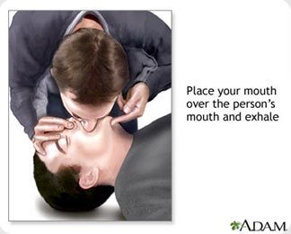
Rescue breaths
One hand on chin, tilt head back, pinch nose closed
Make seal over mouth, breathe into mouth
1 breath every 5 seconds
Chest should rise, not stomach (if stomach rises, readjust)

Slide 18
Narcan® Nasal Product
https://www.narcan.com/
Narcan® Administration

Slide 19
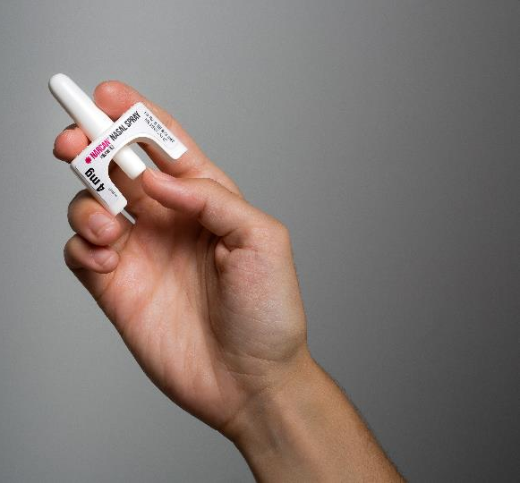
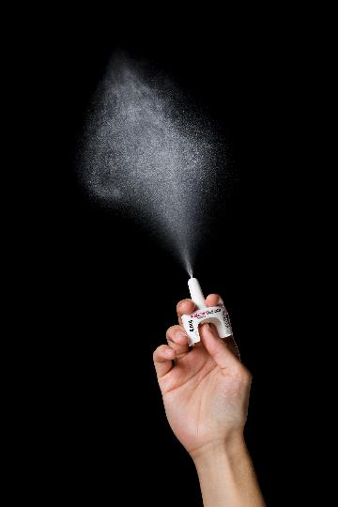
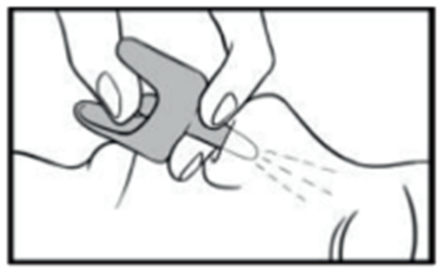
Administer narcan®
Lay person on their back
Remove from box. Peel back tab with circle to open
Hold with your thumb on bottom of plunger and your first and middle fingers on either side of the nozzle
Tilt person’s head back
Insert tip of nozzle into one nostril until your fingers on either side of nozzle are against bottom of person’s nose
Press plunger firmly to give dose and remove from nostril after giving dose
Administer another dose in same fashion if there is little or no response after 2 minutes
Continue rescue breathing every 5 seconds between doses

Slide 20
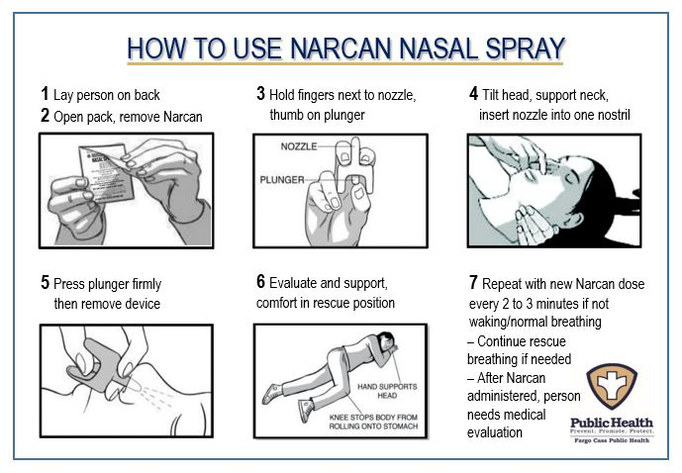

Slide 21
Medication storage
Naloxone should be kept at room temperature
Do not let it freeze in your car
It should be protected from light
The naloxone shelf life is 2 years

Slide 22
Naloxone Administration Trainings available
To schedule a Naloxone Administration Training, contact:
Ariel Johnson
Richland County Health Department
aljohnson@co.richland.nd.us
701.476701.642-7735

